Slide 1
UNIT II
Data Preprocessing:
An Overview, Data Cleaning, Data Integration, Data Reduction, Data Transformation and Data Discretization.

Slide 2
Data Reduction:
Data reduction techniques can be applied to obtain a reduced representation of the data set that is much smaller in volume, yet closely maintains the integrity of the original data. That is, mining on the reduced data set should be more efficient yet produce the same (or almost the same) analytical results.
Overview of Data Reduction Strategies:
Data reduction strategies include dimensionality reduction, numerosity reduction, and data compression.
Dimensionality reduction is the process of reducing the number of random variables or attributes under consideration. Dimensionality reduction methods include wavelet transforms and principal components analysis, which transform or project the original data onto a smaller space. Attribute subset selection is a method of dimensionality reduction in which irrelevant, weakly relevant, or redundant attributes or dimensions are detected and removed.

Slide 3
Numerosity reduction techniques replace the original data volume by alternative, smaller forms of data representation. These techniques may be parametric or non parametric. For parametric methods, a model is used to estimate the data, so that typically only the data parameters need to be stored, instead of the actual data. Regression and log-linear models are examples. Nonparametric methods for storing reduced representations of the data include histograms, clustering, sampling, and data cube aggregation.
In data compression, transformations are applied so as to obtain a reduced or “compressed” representation of the original data. If the original data can be reconstructed from the compressed data without any information loss, the data reduction is called lossless. If, instead, we can reconstruct only an approximation of the original data, then the data reduction is called lossy. There are several lossless algorithms for string compression; however, they typically allow only limited data manipulation. Dimensionality reduction and numerosity reduction techniques can also be considered forms of data compression.

Slide 4
Wavelet Transforms:
The discrete wavelet transform (DWT) is a linear signal processing technique that, when applied to a data vector X, transforms it to a numerically different vector, X¹, of wavelet coefficients. The two vectors are of the same length. When applying this technique to data reduction, we consider each tuple as an n-dimensional data vector, that is, X=(x₁,x₂, ,x_{n}), depicting n measurements made on the tuple from n database attributes.
The general procedure for applying a discrete wavelet transform uses a hierarchical pyramid algorithm that halves the data at each iteration, resulting in fast computational speed. The method is as follows:
1. The length, L, of the input data vector must be an integer power of 2. This condition can be met by padding the data vector with zeros as necessary (L >= n).
2. Each transform involves applying two functions. The first applies some data smoothing, such as a sum or weighted average. The second performs a weighted difference, which acts to bring out the detailed features of the data.

Slide 5
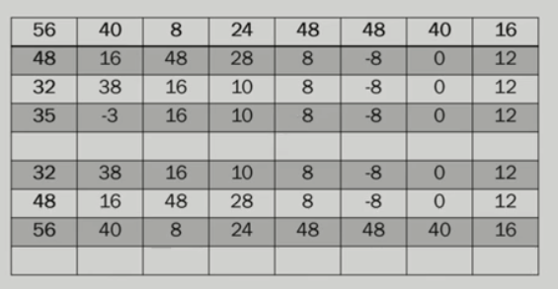
3. The two functions are applied to pairs of data points in X, that is, to all pairs of measurements (x_{2i},x_{2i +1}). This results in two data sets of length L/2.
4. The two functions are recursively applied to the data sets obtained in the previous loop, until the resulting data sets obtained are of length 2.
5. Selected values from the data sets obtained in the previous iterations are designated the wavelet coefficients of the transformed data.

Slide 6
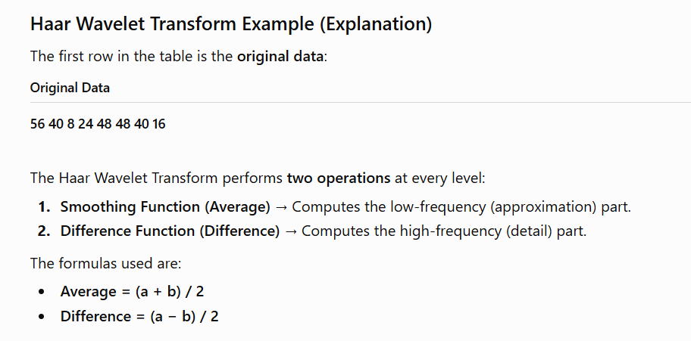

Slide 7
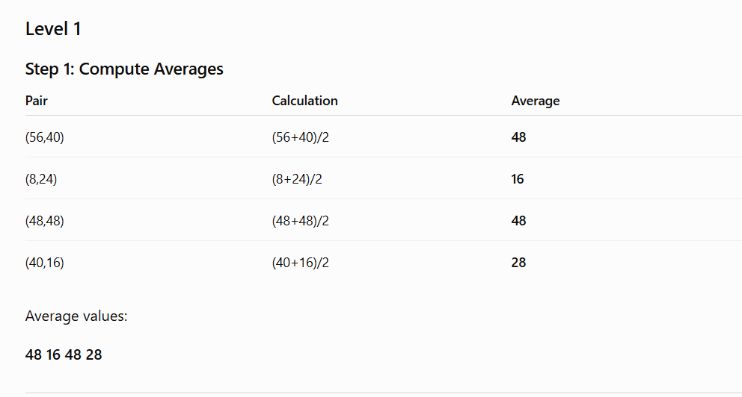
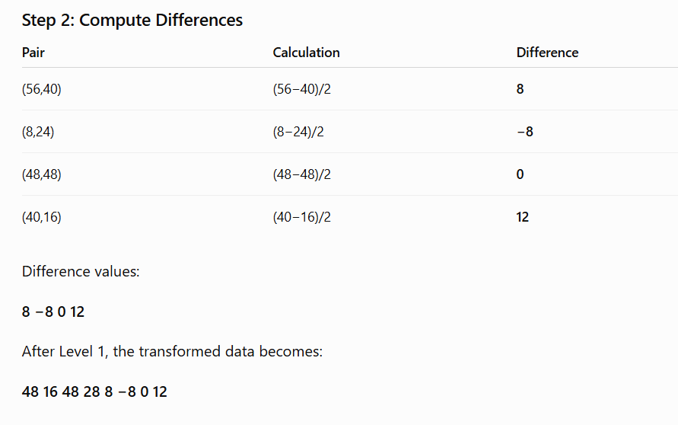

Slide 8
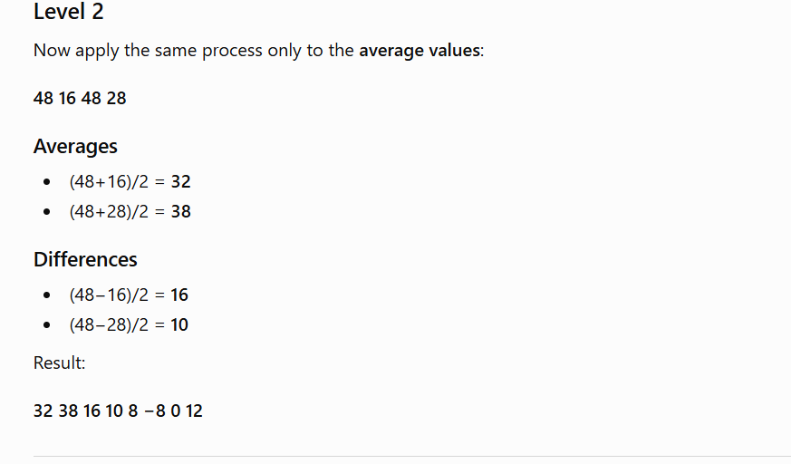
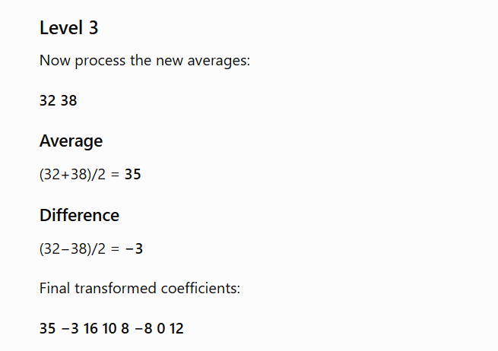

Slide 9
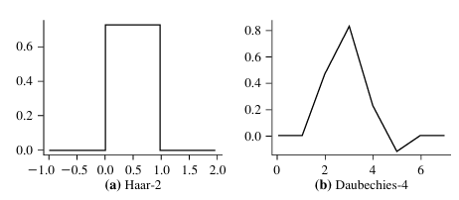
some wavelet families:
Why Wavelet Transform is useful for Data Reduction
After transformation:
Most of the important information is concentrated in a few large coefficients
Small coefficients contribute less and can be discarded
So, instead of storing all values, we store only the strongest coefficients
This gives a compressed representation of the data

Slide 10
Reconstruction of Original Data
If we have the wavelet coefficients, we can apply the inverse DWT to reconstruct:
either the original data exactly (if all coefficients are kept)
or an approximation (if only major coefficients are kept)
Additional Note on Wavelet Transform
Wavelet coefficients can also be obtained using matrix multiplication.
The input data vector is multiplied by a matrix to produce the wavelet coefficients.
The matrix used depends on the specific Discrete Wavelet Transform (DWT).
Property of the Matrix
The matrix must be orthonormal, which means:
Each column is a unit vector
Different columns are mutually orthogonal
Because of this property:
the inverse of the matrix = transpose of the matrix
this makes it easy to reconstruct the original data from the transformed data

Slide 11
Wavelet Transform on Multidimensional Data
Wavelet transforms are not limited to one-dimensional data. They can also be applied to multidimensional data such as a data cube.
How it is applied to multidimensional data
For a data cube, the transform is applied dimension by dimension:
First apply the wavelet transform on the first dimension
Then apply it on the second dimension
Continue this process for the remaining dimensions
So, the transform is performed separately along each dimension of the cube.
Computational Complexity
The computational complexity of applying wavelet transforms to a data cube is:
O(number of cells in the cube)
This means the complexity is linear with respect to the number of cells, making it efficient even for large multidimensional datasets.

Slide 12
Principal Component Analysis (PCA)
Principal Component Analysis (PCA) is a dimensionality reduction technique used to reduce the number of attributes in a dataset while preserving as much important information as possible.
It is also called the Karhunen–Loève (K-L) method.
Basic Idea of PCA
Suppose a dataset has n attributes (dimensions). PCA tries to find k new orthonormal vectors (where k ≤n ) that best represent the original data.
These new vectors are called principal components
The original data is then projected onto this smaller set of components
As a result, the data is represented in a smaller space, achieving dimensionality reduction

Slide 13
Principal Components Analysis (PCA):

Slide 15
Applications and Characteristics of PCA
1. Works with Ordered and Unordered Attributes
PCA can be applied to both:
ordered attributes
unordered attributes
2. Can Handle Sparse and Skewed Data
Works well for sparse data
Also useful for skewed data
3. Handles Multidimensional Data
If the data has many dimensions, PCA can reduce it to fewer dimensions, often 2D or 3D, for easier analysis and visualization.
4. Used in Other Data Analysis Methods
Principal components can be used as input for:
Multiple Regression
Cluster Analysis

Slide 16
Attribute Subset Selection:
Attribute subset selection reduces the data set size by removing irrelevant or redundant attributes (or dimensions). The goal of attribute subset selection is to find a minimum set of attributes such that the resulting probability distribution of the data classes is as close as possible to the original distribution obtained using all attributes. Mining on a reduced set of attributes has an additional benefit: It reduces the number of attributes appearing in the discovered patterns, helping to make the patterns easier to understand.
“How can we find a ‘good’ subset of the original attributes?”
In attribute subset selection, the problem is to choose the best subset of attributes from the original set.
If there are n attributes, then the total number of possible subsets is:
2^n
So, checking every possible subset to find the best one is called exhaustive search.
Basic heuristic methods(Greedy approach) of attribute subset selection include the techniques that as follow:

Slide 17
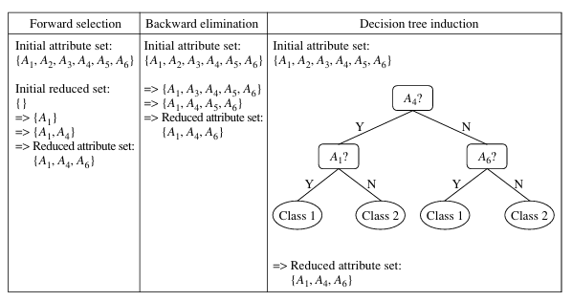

Slide 18
Stepwise forward selection:
Stepwise backward elimination:
Combination of forward selection and backward elimination:
Decision tree induction:

Slide 19
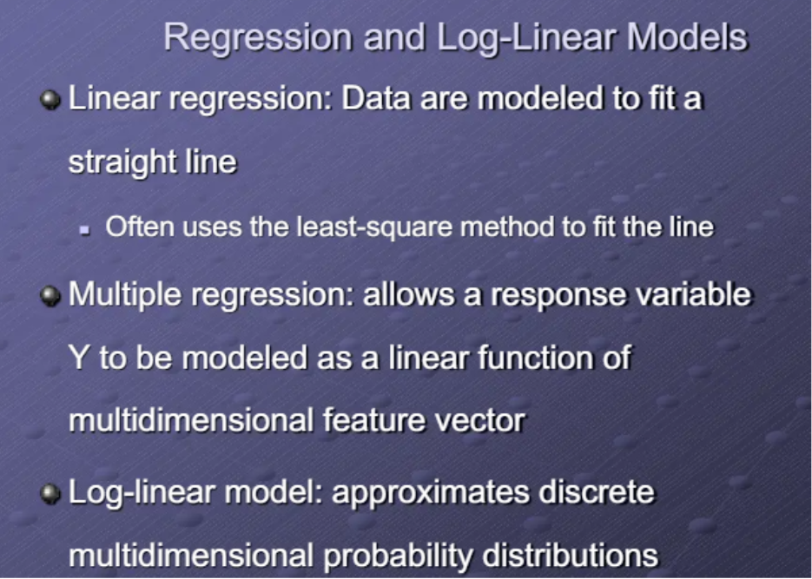
Regression and Log-Linear Models: Parametric Data Reduction:

Slide 20
Suppose a dataset has 3 attributes:
Gender
Age Group
City
Instead of calculating probabilities for every Gender × Age × City combination, a log-linear model can estimate them using smaller combinations such as:
Gender × Age
Age × City
Gender × City

Slide 21
Histograms:
Histograms use binning to approximate data distributions and are a popular form of data reduction.
A histogram for an attribute, A, partitions the data distribution of A into disjoint subsets, referred to as buckets or bins. If each bucket represents only a single attribute–value/frequency pair, the buckets are called singleton buckets.
Example: The following data are a list of AllElectronics prices for commonly sold items (rounded to the nearest dollar).
The numbers have been sorted: 1, 1, 5, 5, 5, 5, 5, 8, 8, 10, 10, 10, 10, 12, 14, 14, 14, 15, 15, 15, 15, 15, 15, 18, 18, 18, 18, 18, 18, 18, 18, 20, 20, 20, 20, 20, 20, 20, 21, 21, 21, 21, 25, 25, 25, 25, 25, 28, 28, 30, 30, 30.
Figure 3.7 shows a histogram for the data using singleton buckets. To further reduce the data, it is common to have each bucket denote a continuous value range for the given attribute. In Figure 3.8, each bucket represents a different $10 range for price.

Slide 22
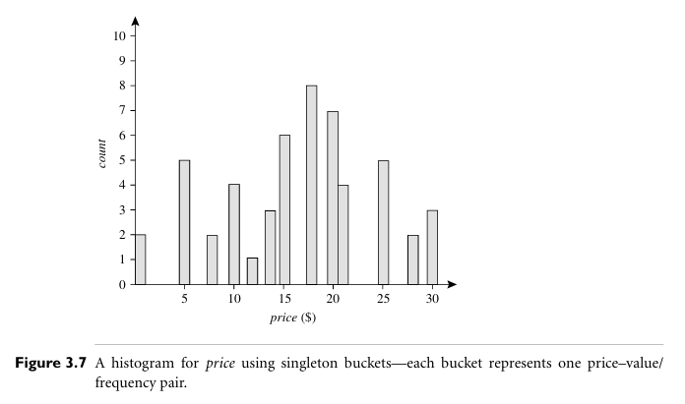

Slide 23
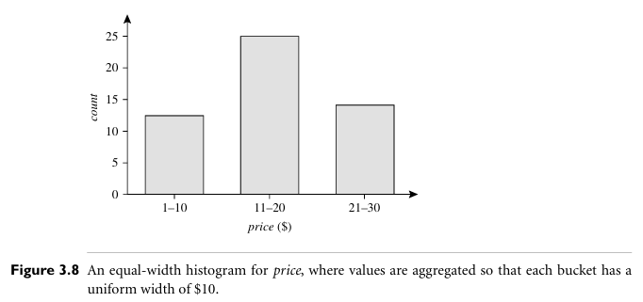
Equal-width: In an equal-width histogram, the width of each bucket range is uniform (e.g., the width of $10 for the buckets in Figure 3.8).
Equal-frequency (or equal-depth): In an equal-frequency histogram, the buckets are created so that, roughly, the frequency of each bucket is constant

Slide 24
Clustering:
Clustering techniques consider data tuples as objects. They partition the objects into groups, or clusters, so that objects within a cluster are “similar” to one another and “dis similar” to objects in other clusters. Similarity is commonly defined in terms of how “close” the objects are in space, based on a distance function.
The “quality” of a cluster may be represented by its diameter, the maximum distance between any two objects in the cluster. Centroid distance is an alternative measure of cluster quality and is defined as the average distance of each cluster object from the cluster centroid.

Slide 25
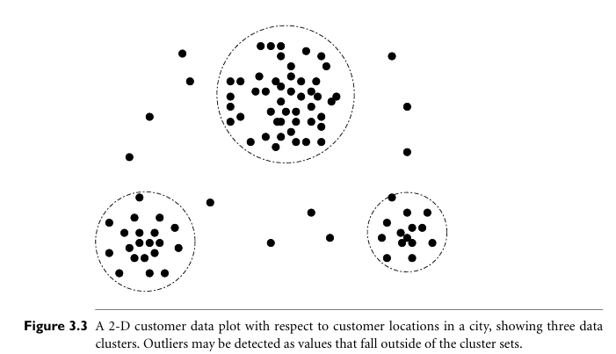

Slide 26
Sampling :
Sampling can be used as a data reduction technique because it allows a large data set to be represented by a much smaller random data sample (or subset). Suppose that a large data set, D, contains N tuples. Let’s look at the most common ways that we could sample D for data reduction, as illustrated in Figure 3.9.
Simple random sample without replacement (SRSWOR) of size s: This is created by drawing s of the N tuples from D (s < N), where the probability of drawing any tuple in D is 1/N, that is, all tuples are equally likely to be sampled.
Simple random sample with replacement (SRSWR) of size s: This is similar to SRSWOR, except that each time a tuple is drawn from D, it is recorded and then replaced. That is, after a tuple is drawn, it is placed back in D so that it may be drawn again.
Cluster sample: If the tuples in D are grouped into M mutually disjoint “clusters,” then an SRS of s clusters can be obtained, where s < M. For example, tuples in a database are usually retrieved a page at a time, so that each page can be considered a cluster.

Slide 27
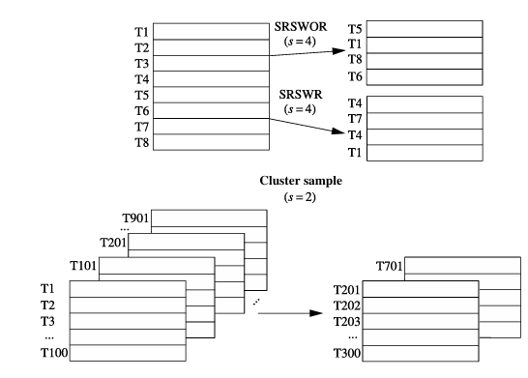
Stratified sample: If D is divided into mutually disjoint parts called strata, a stratified sample of D is generated by obtaining an SRS at each stratum. This helps ensure a representative sample, especially when the data are skewed. For example, a stratified sample may be obtained from customer data, where a stratum is created for each customer age group.

Slide 28
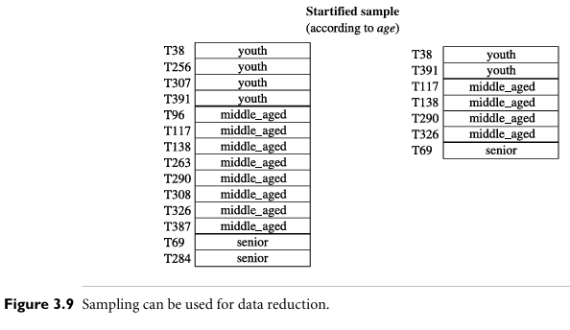

Slide 29
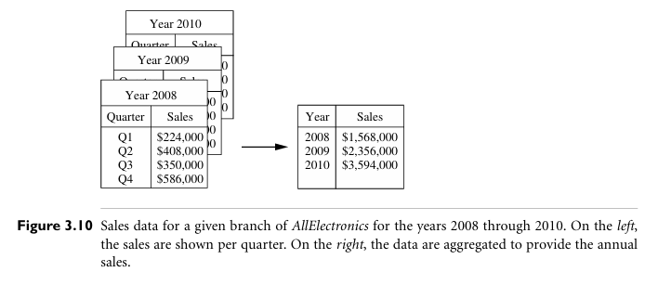
Data Cube Aggregation:
Imagine that you have collected the data for your analysis. These data consist of the AllElectronics sales per quarter, for the years 2008 to 2010. You are, however, interested in the annual sales (total per year), rather than the total per quarter. Thus, the data can be aggregated so that the resulting data summarize the total sales per year instead of per quarter. This aggregation is illustrated in Figure 3.10.
The resulting data set is smaller in volume, without loss of information necessary for the analysis task.

Slide 30
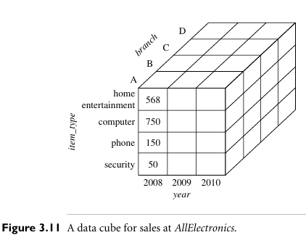

Slide 31
Data Transformation and Data Discretization:
This section presents methods of data transformation. In this preprocessing step, the data are transformed or consolidated so that the resulting mining process may be more efficient, and the patterns found may be easier to understand. Data discretization, a form of data transformation.
Data Transformation Strategies Overview:
In data transformation, the data are transformed or consolidated into forms appropriate for mining. Strategies for data transformation include the following:
Smoothing, which works to remove noise from the data. Techniques include binning, regression, and clustering.
Attribute construction, where new attributes are constructed and added from the given set of attributes to help the mining process.
Aggregation, where summary or aggregation operations are applied to the data. For example, the daily sales data may be aggregated so as to compute monthly and annual total amounts.

Slide 32
4. Normalization, where the attribute data are scaled so as to fall within a smaller range, such as -1.0 to 1.0, or 0.0 to 1.0.
5. Discretization, where the raw values of a numeric attribute (e.g., age) are replaced by interval labels (e.g., 0–10, 11–20, etc.) or conceptual labels (e.g., youth, adult, senior). The labels, in turn, can be recursively organized into higher-level concepts, resulting in a concept hierarchy for the numeric attribute. Figure 3.12 shows a concept hierarchy for the attribute price.
6. Concept hierarchy generation for nominal data, where attributes such as street can be generalized to higher-level concepts, like city or country. Many hierarchies for nominal attributes are implicit within the database schema and can be automatically defined at the schema definition level.

Slide 33
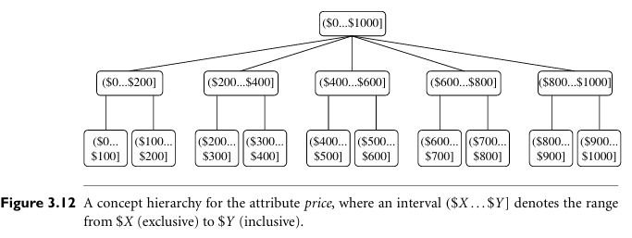

Slide 34
Discretization techniques can be categorized based on how the discretization is performed, such as whether it uses class information or which direction it proceeds (i.e., top-down vs. bottom-up). If the discretization process uses class information, then we say it is supervised discretization. Otherwise, it is unsupervised.
If the process starts by first finding one or a few points (called split points or cut points) to split the entire attribute range, and then repeats this recursively on the resulting intervals, it is called top-down discretization or splitting.
This contrasts with bottom-up discretization or merging, which starts by considering all of the continuous values as potential split-points, removes some by merging neighborhood values to form intervals, and then recursively applies this process to the resulting intervals.

Slide 35
Example
Continuous values (Age):
18, 20, 22, 25, 28, 35, 42, 50, 60
After discretization:
18–25 → Young
26–40 → Adult
41–60 → Senior
Marks | Result
35 | Fail
40 | Pass
45 | Pass
25 | Fail
18–25
26–40
41–60
No class information is used

Slide 36
Top-Down
Entire Range
18------------------------60↓
Split
18---------40---------60↓
Split Again
18----30----40------60
Bottom-Up
20 22 25 28 35↓
Merge
18 20 22
25 28
35↓
Merge Again
18–28
35
Finally 18-35

Slide 37
Data discretization and concept hierarchy generation are also forms of data reduction. The raw data are replaced by a smaller number of interval or concept labels. This simplifies the original data and makes the mining more efficient. The resulting patterns mined are typically easier to understand. Concept hierarchies are also useful for mining at multiple abstraction levels.
Data Transformation by Normalization:
The measurement unit used can affect the data analysis. For example, changing measurement units from meters to inches for height, or from kilograms to pounds for weight, may lead to very different results.
In general, expressing an attribute in smaller units will lead to a larger range for that attribute, and thus tend to give such an attribute greater effect or “weight.” To help avoid dependence on the choice of measurement units, the data should be normalized or standardized. This involves transforming the data to fall within a smaller or common range such as [-1,1] or [0.0, 1.0].

Slide 38
Normalization is particularly useful for classification algorithms involving neural networks or distance measurements such as nearest-neighbor classification and clustering.
There are many methods for data normalization. We study min-max normalization, z-score normalization, and normalization by decimal scaling. For our discussion, let A be a numeric attribute with n observed values, v1,v2, ,vn.

Slide 39


Min-max normalization performs a linear transformation on the original data. Sup pose that min_A and max_A are the minimum and maximum values of an attribute, A. Min-max normalization maps a value, vi, of A to vi in the range [new min_A, new max_A] by computing:
Min-max normalization preserves the relationships among the original data values. It will encounter an “out-of-bounds” error if a future input case for normalization falls outside of the original data range for A

Slide 40
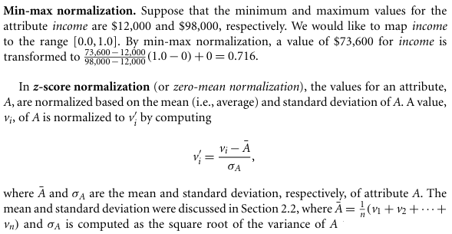

Slide 41
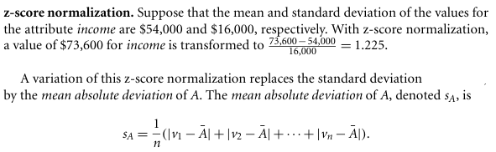
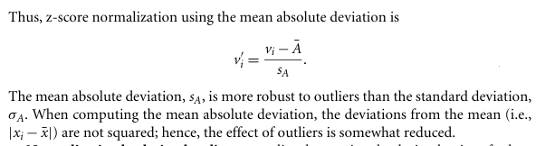

Slide 42
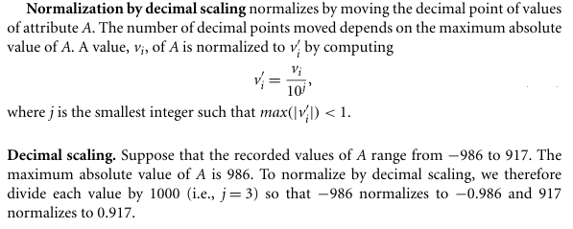

Slide 43
Discretization by Binning:
Binning is a top-down splitting technique based on a specified number of bins.
Example: attribute values can be discretized by applying equal-width or equal-frequency binning, and then replacing each bin value by the bin mean or median, as in smoothing by bin means or smoothing by bin medians, respectively. These techniques can be applied recursively to the resulting partitions to generate concept hierarchies.
Discretization by Histogram Analysis:
Histogram analysis is an unsupervised discretization technique because it does not use class information. A histogram partitions the values of an attribute, A, into disjoint ranges called buckets or bins.
Various partitioning rules can be used to define histograms:
Equal-width histogram: The values are partitioned into equal-size partitions or ranges.
Equal-frequency histogram: The values are partitioned so that, ideally, each partition contains the same number of data tuples.

Slide 44
The histogram analysis algorithm can be applied recursively to each partition in order to automatically generate a multilevel concept hierarchy, with the procedure terminating once a pre-specified number of concept levels has been reached. A minimum interval size can also be used per level to control the recursive procedure. This specifies the minimum width of a partition, or the minimum number of values for each partition at each level. Histograms can also be partitioned based on cluster analysis of the data distribution.
Discretization by Cluster, Decision Tree, and Correlation Analyses:
Cluster:
A clustering algorithm can be applied to discretize a numeric attribute, A, by partitioning the values of A into clusters or groups. Clustering takes the distribution of A into consideration, as well as the closeness of data points, and therefore is able to produce high-quality discretization results.

Slide 45
Clustering can be used to generate a concept hierarchy for A by following either a top-down splitting strategy or a bottom-up merging strategy, where each cluster forms a node of the concept hierarchy. In the former, each initial cluster or partition may be further decomposed into several subclusters, forming a lower level of the hierarchy. In the latter, clusters are formed by repeatedly grouping neighboring clusters in order to form higher-level concepts.
Decision trees:
Different techniques to generate decision trees for classification can be applied to discretization. Such techniques employ a top-down splitting approach. Decision tree approaches to discretization are supervised, that is, they make use of class label information.
For example, we may have a data set of patient symptoms where each patient has an associated diagnosis class label. Class distribution information is used in the calculation and determination of split-points. Intuitively, the main idea is to select split-points so that a given resulting partition contains as many tuples of the same class as possible.

Slide 46
Age | Diagnosis
22 | Healthy
25 | Healthy
30 | Healthy
45 | Diabetes
50 | Diabetes
60 | Diabetes
Here, the class label is Diagnosis.
The algorithm searches for a split point that separates the classes as clearly as possible.
A split at Age = 37.5 produces:
Age ≤ 37.5 → Mostly Healthy
Age > 37.5 → Mostly Diabetes

Slide 47
Entropy is the most commonly used measure for selecting the best split point during decision tree-based discretization. It measures the impurity or uncertainty of the data.
Low entropy → Most records belong to the same class (high purity).
High entropy → Records belong to different classes (high impurity). Possible split points are between adjacent values.
For example:
22.5
27.5
35
42.5
47.5
Age | Class
20 | Healthy
25 | Healthy
30 | Healthy
40 | Diabetes
45 | Diabetes
50 | Diabetes

Slide 48
Age | Class
40 | Diabetes
45 | Diabetes
50 | Diabetes
Left partition:
Entropy = 0 (all belong to the same class)
Right partition:
Entropy = 0
Overall entropy = 0, which is the minimum possible value.
Suppose the split is Age = 35.
Therefore,
Age = 35 is selected as the best split point.
Age | Class
20 | Healthy
25 | Healthy
30 | Healthy

Slide 49
Entropy is the most commonly used measure for this purpose. To discretize a numeric attribute, A, the method selects the value of A that has the minimum entropy as a split-point, and recursively partitions the resulting intervals to arrive at a hierarchical discretization. Such discretization forms a concept hierarchy for A.
Because decision tree–based discretization uses class information, it is more likely that the interval boundaries (split-points) are defined to occur in places that may help improve classification accuracy.
Correlation Analyses:
Measures of correlation can be used for discretization. ChiMerge is a discretization method, which employs a bottom-up approach by finding the best neighboring intervals and then merging them to form larger intervals, recursively.
As with decision tree analysis, ChiMerge is supervised in that it uses class information. The basic notion is that for accurate discretization, the relative class frequencies should be fairly consistent within an interval. Therefore, if two adjacent intervals have a very similar distribution of classes, then the intervals can be merged. Otherwise, they should remain separate.

Slide 50
ChiMerge proceeds as follows:
Initially, each distinct value of a numeric attribute A is considered to be one interval. are performed for every pair of adjacent intervals. Adjacent intervals with the least are merged together, because low for a pair indicate similar class distributions. This merging process proceeds recursively until a predefined stopping criterion is met.
Concept Hierarchy Generation for Nominal Data:
Nominal attributes have a finite number of distinct values, with no ordering among the values.
Ex: Geographic location, job category, and item type.
Four methods for the generation of concept hierarchies for nominal data, as follows:
Specification of a partial ordering of attributes explicitly at the schema level by users or experts.
Specification of a portion of a hierarchy by explicit data grouping.
Specification of a set of attributes, but not of their partial ordering.
Specification of only a partial set of attributes.

Slide 51
Concept hierarchy generation based on the number of distinct values per attribute:
Suppose a user selects a set of location-oriented attributes—street, country, province or state, and city—from the AllElectronics database, but does not specify the hierarchical ordering among the attributes. A concept hierarchy for location can be generated automatically, as illustrated in Following Figure.
First, sort the attributes in ascending order based on the number of distinct values in each attribute. country (15), province or state (365), city (3567), and street (674,339).
Second, generate the hierarchy from the top down according to the sorted order, with the first attribute at the top level and the last attribute at the bottom level.
Finally, the user can examine the generated hierarchy, and when necessary, modify it to reflect desired semantic relationships among the attributes.
In this example, it is obvious that there is no need to modify the generated hierarchy. Note that this heuristic rule is not foolproof. For example, a time dimension in a database may contain 20 distinct years, 12 distinct months, and 7 distinct days of the week. However, this does not suggest that the time hierarchy should be “year < month < days of the week,” with days of the week at the top of the hierarchy.

Slide 52
